Slide 1
Supermarket Stores Branches Statistical Analysis
G.M OYEWOLE

Slide 2
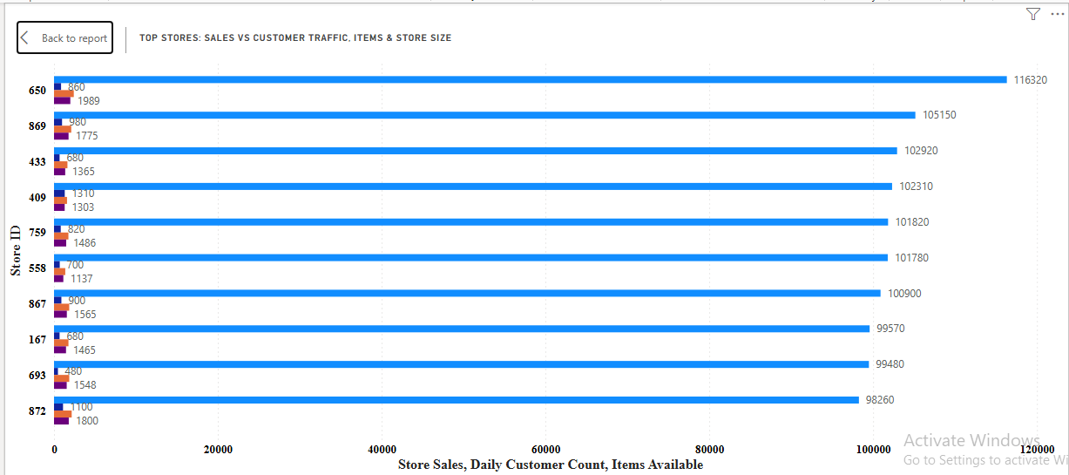
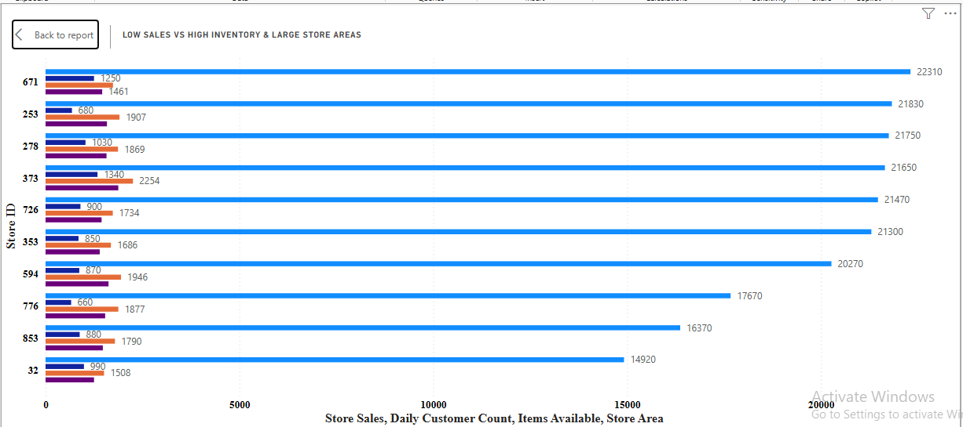
TOP & BOTTOM PERFORMERS
Highest Sales: Store 650 with sales of 116,320
Lowest Sales: Store 32 with sales of 14,920
Influencing Factors:
Larger store areas (1989) and a higher item count (2414) may have supported higher sales in Store 650.
High customer counts (990) do not always guarantee higher sales in Store 32, stores with optimized customer experience may convert better.

Slide 3
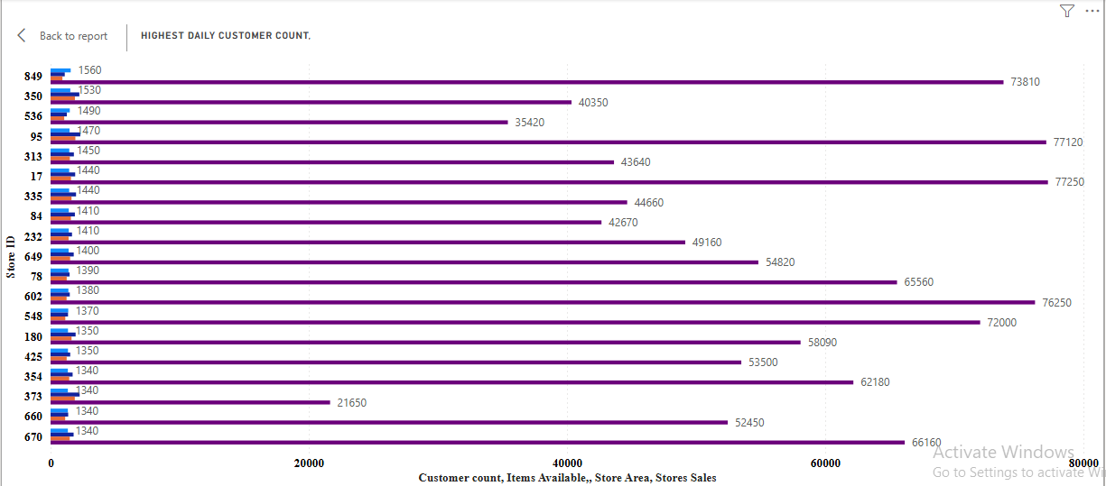
Customer Insights
Customer Count
Highest Daily Customer Counts: Store 849 with 1,560 customers.
Lowest Customer Counts: Store 40 with 10 customers.
Contributing Factors:
Location: Stores situated in high-traffic areas may attract more customers and low-traffic areas the opposite.
Inventory Type: the low daily customer walk-in did not so much affect the stores sales, which suggests that the items available may be for a particular demographic.

Slide 4
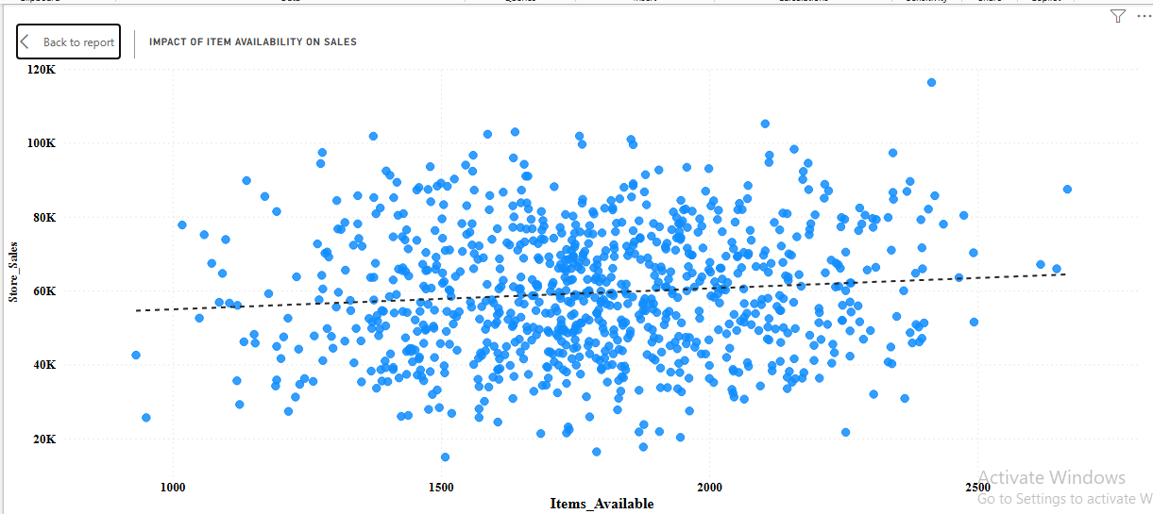
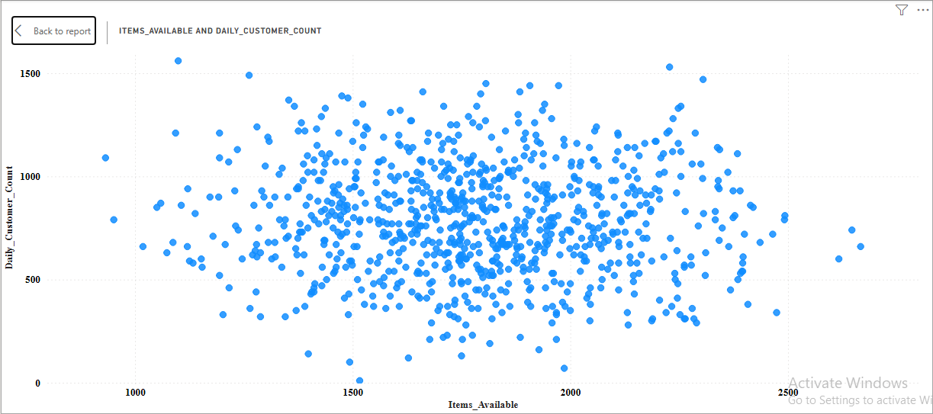


Inventory & Space Efficiency
Items Available vs. Sales: There is a very weak relationship between these two. However, top 9 stores with more items available had high sales. 650 is the 10th highest available items and also had highest sales.
Items Available vs. Daily Customer Count: The correlation between the number of items available and customer count is a negative very weak, suggesting that merely increasing inventory does not indicate higher foot traffic.

Slide 5
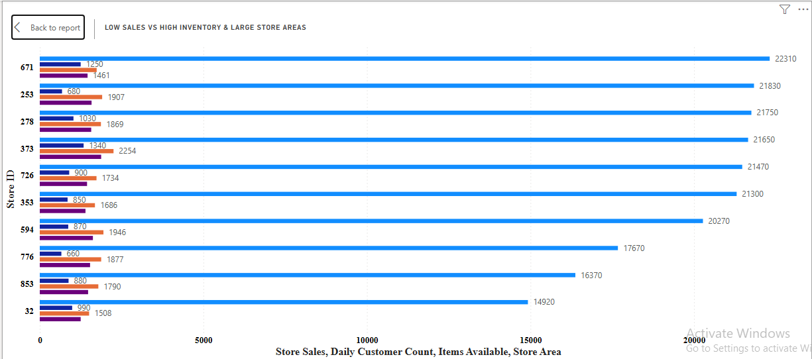
Underperforming Stores
Average items per store were 1782, and average sales was 59,351. There are 162 stores with above average items and below average sales showing high inventory and high store area (Increase in store area correlated with increase in items available) but low conversion rates – resulting in higher operational costs. This can also lead to drastic reduced profitability in such stores.
Stores with a high number of available items but low sales suggest a potential mismatch between product offerings and customer preferences.

Slide 6
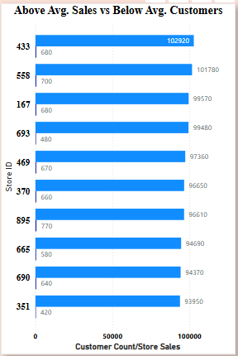
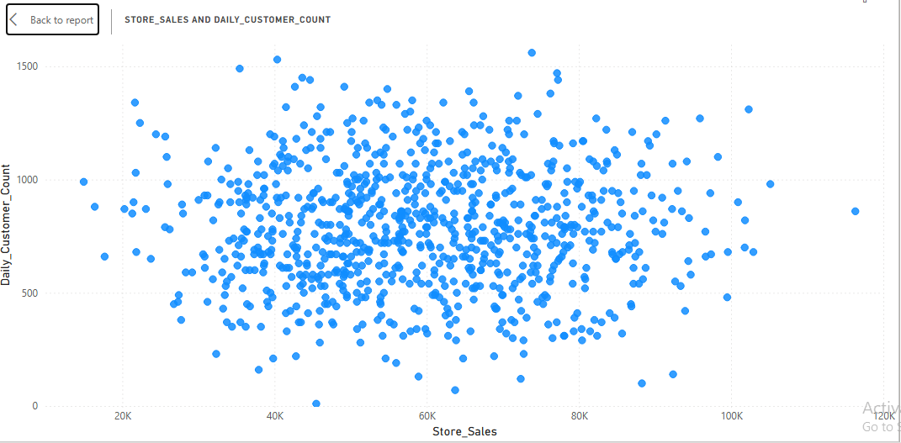
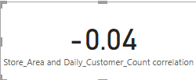
PROFITABILITY DRIVERS
Daily Customer Count vs. Sales: There’s a weak negative correlation between customer count and sales.
Identifying Deviations: The negative correlation is that 23.88% (214) stores below the average number of daily customer walk-in (786), have astounding sales higher than the average store sales.

Slide 7
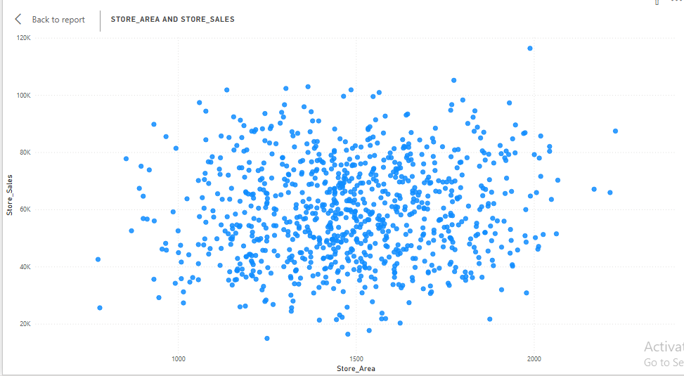
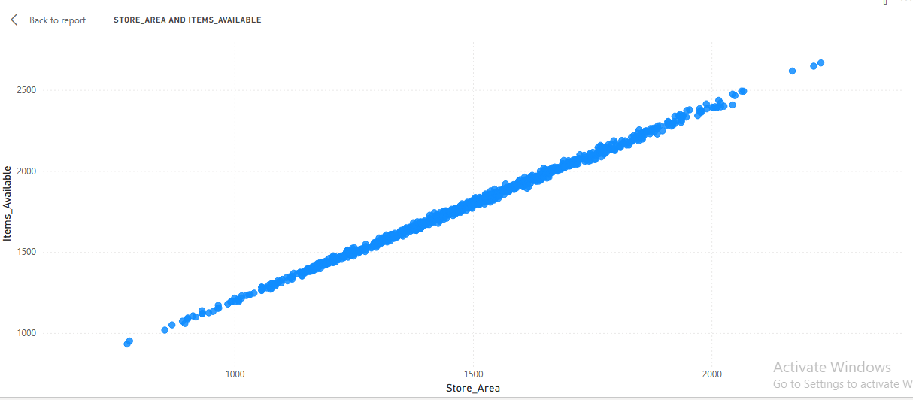
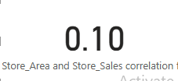
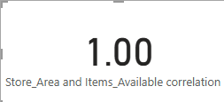
AREA AND SALES CORRELATION
Store Area vs. Sales: There is very weak correlation between larger store areas and higher sales.
Store Area vs. Items Available: The correlation is perfect; however, efficiency in inventory management is crucial for maximizing profitability. This correlation unfortunately does not always translate to higher sales.

Slide 8
STRATEGIC RECOMMENDATIONS
Optimized Stores
Best Practices: Identify high-performing stores and assess their strategies for potential replication in underperforming locations.
Customer Loyalty
Increasing Sales/Customer Ratio: Focus on stores with low sales relative to customer counts to enhance sales conversion. should improve product placements and pricing strategies to boost conversions.
Space Optimization
Optimize Store Layout: Rearrange layouts to highlight high-demand and seasonal products better.
Reduce Store Area: Consider cost-saving measures in stores with high operational costs and low sales performance, like reducing the store area, while maintaining customer loyalty.
Pricing Impact
Pricing Strategies: Evaluate if pricing variations are affecting sales and develop tailored pricing strategies for different stores, based on local market conditions.

Slide 9
STRATEGIC RECOMMENDATIONS
Marketing Strategies
Marketing Campaigns: Tailor marketing initiatives based on local demographics and customer preferences.
Enhance Training: Provide staff training in stores with high customer counts but low conversion rates to improve customer service.
Targeted Promotions: Identify stores that could benefit from specific marketing efforts based on customer behaviours or demographic insights.
Promotion Effectiveness: Conduct A/B tests to determine the effectiveness of marketing campaigns tailored to these stores.
Customer Engagement
Feedback Mechanism: Implement systems for collecting customer feedback to identify areas for improvement and enhance product offerings, especially in stores with high traffic, but low sales.
Conclusion
By analysing the recommended areas and implementing the recommended strategies, stores can enhance profitability, improve customer satisfaction, and optimize operational efficiency.

